Slide 1

Deploying ASP.NET Applications
Chapter 11

Slide 2
What Are You Going To Learn?
At the end of this lesson, you will be able to:
Apply 3 different approaches to deploy a Website
XCopy
VS Copy Website
Deploy Precompiled Web application
The Windows Installer (not in the syllabus)

Slide 3
Deployment
deployment entails the process of getting your final application onto the production server and making it live.
But prior to that, it also consists of setting up your project to work in various environments before you actually host it on the production environment.

Slide 4
Test Environment
involved with the testing phase, which rigorously scrutinize every aspect of the code, its functionalities and its performance
perform various testing processes on the application on an environment that closely resembles the production environment
Plan performance, load or stress test

Slide 5
Web Server
development environment tools, extra software and unnecessary applications that are not expected to run on the production environment SHOULD NOT be installed
Check
Unforeseen dependencies inherited from your development environment
hardware mismatch
Configuration mismatched (database, mail setting, etc.)

Slide 6
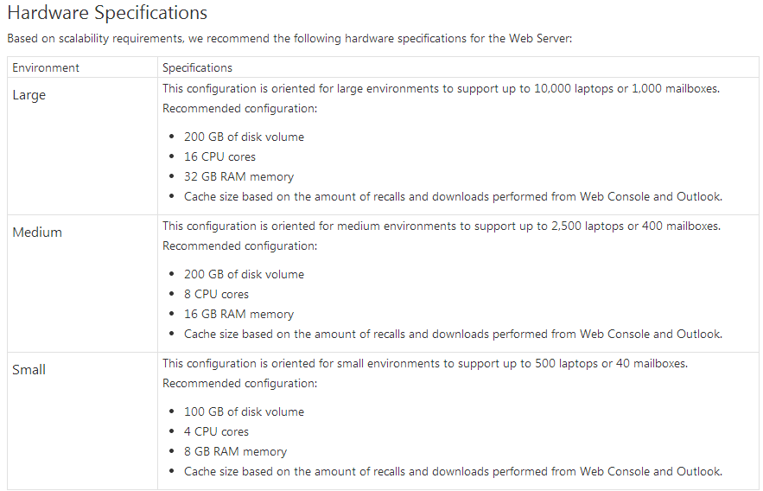
Web Server Requirements
source: http://documentation.commvault.com/

Slide 7
Staging Environment
to actually run the system as if it would run on a live production environment
is the place where you might want to do last minute tests on everything
perform stress and load tests, run lots of other real-time scenarios and see if it works as expected

Slide 8
Production Environment
Products are actually put into operation for their intended uses by end users, i.e. the products are being used by end users in a real-time situation.

Slide 9
Transferring Files to Server
<configuration>
<system.web>
<!--
Set compilation debug="true" to insert debugging
symbols into the compiled page. Because this
affects performance, set this value to true only
during development.
-->
<compilation debug="false“>
</compilation>
</configuration>
</system.web>

Slide 10
Deployment steps
Build Website
Copy Website
Create Virtual Directory in Web Server

Slide 11
XCopy
We can copy the assembly to another server and we do not need to stop/start IIS while copying.
Allows us to move
Files
Directories
Entire drives

Slide 12
XCopy Syntax
xcopy [source] [destination] [Parameter]
Parameter | Description
/f | Displays the file names from the source and destination files while copying process is occurring
/e | Copies all subdirectories regardless whether these folders contain files
/k | Ensures the read-only settings remain in place during the copying process
/h | To include the hidden and system files
For more details, read reference [1]

Slide 13
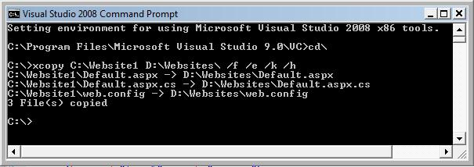
DEMO
Xcopy Command
Notes:
The 01_SimpleMaster.master page uses Cascading Style Sheets to create the page layout. You should strive to avoid using HTML tables for layout. HTML tables should be used only to display tabular information.
The layout consists of 2 columns and 2 content place holder controls.
In the 02_SimpleContent page , you can chose to put the content into with place holder, by specify the content place holder ID

Slide 14
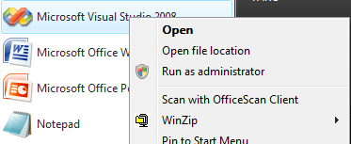
Using Visual Studio Tools
Run VS in the context of administrator account
Right-click VS icon

Slide 15
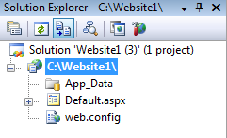
VS Copy Website Option
(1)
Copy Website

Slide 16
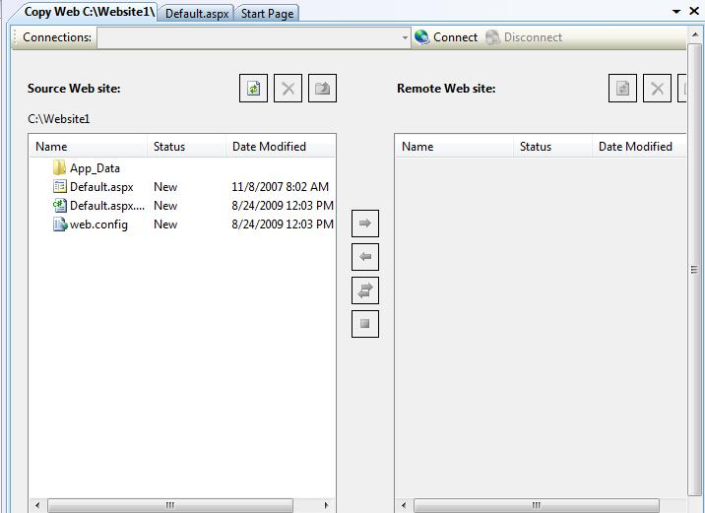
(2)
Connect to a Remote Server

Slide 17
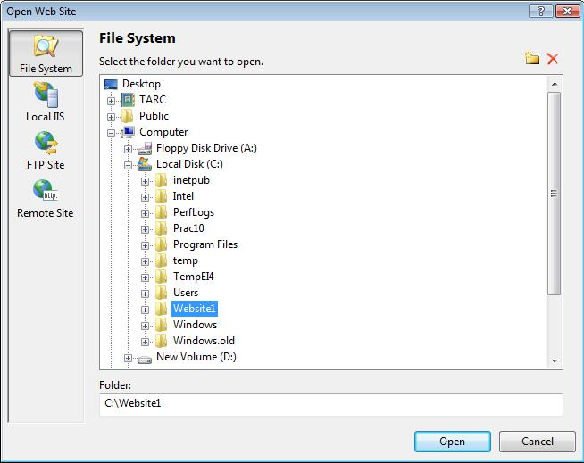
File System: File Explorer
(3)
Select Destination
Local IIS: To use local (not remote) IIS to create new virtual directory
FTP Site: to connect to a remote server using FTP
Remote Site: Connect to a remote site using FrontPageServer Extensions. Can choose to connect to the remote server using Secure Sockets Layer (SSL)

Slide 18
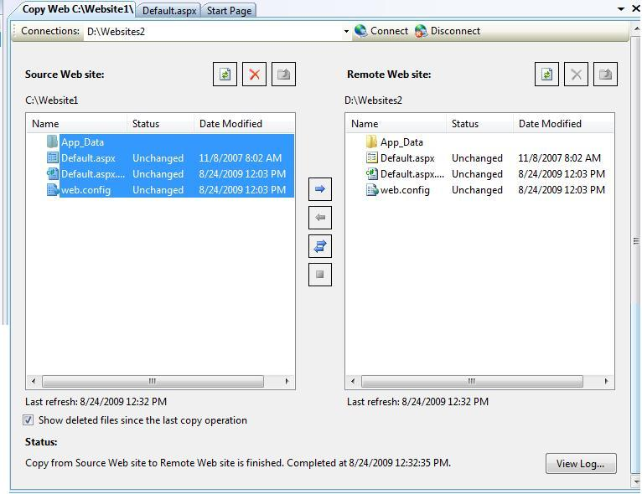
(4)
Transfer files
(5)
View Log

Slide 19
Deploy a Precompiled Web App
Precompilation
Each page is built and compiled into a single application DLL and placeholder files.
Make difficult for your code to be stolen or changed
WHY precompilation????
Notes:
Precompilation is done so that no source code is delivered to your clients.

Slide 20
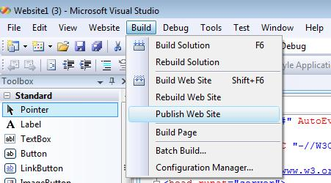
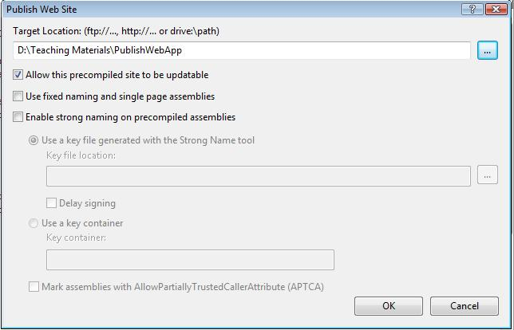
(1) Publish Web Site
(2)
Select Destination

Slide 21
What Have You Learnt?
ASP.NET .NET Framework
MasterPage Navigation Control
Event Handlers Client-event Server-event
Database Data Access Controls Advanced database-handling
Authentication Authorization
State management QueryString Cookie Session Application Cache
Validation Controls
User controls custom controls
Exception handling try-catch-finally Page_Error Application Error Custom Error Pages
Configuration Optimization
Deployment

